Slide 1
WebSocket
WebSocket is a full-duplex (two-way communication) protocol that is used in the same scenario of client-server communication.
It is a stateful protocol, which means the connection between client and server will keep alive until it is terminated by either client or server, after closing the connection by either of the client and server, the connection is terminated from both the end.
WebSockets do not use the http:// or https:// scheme (because they do not follow the HTTP protocol).
Rather, WebSocket URIs use a new scheme ws: (or wss: for a secure WebSocket).
The remainder of the URI is the same as an HTTP URI: a host, port, path and any query parameters.
Example:- ws://example.com:8000/ws/chat

Slide 2
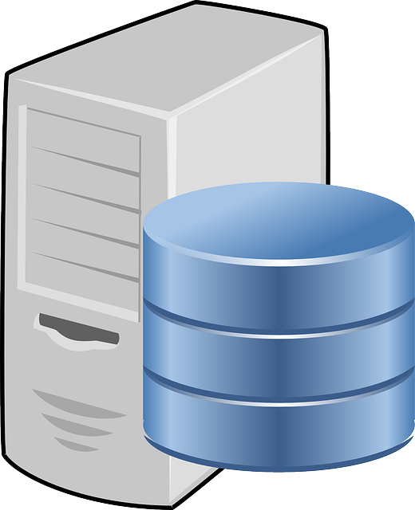

How WebSocket Works
Server
HTTP Request
Handshake
WebSocket Two-way Communication
Client
Close
Client sends regular HTTP request with an additional header to be requested.
The Server gets the HTTP request and notices the request for the Upgrade header. This lets the Server know that we are requesting for a WebSocket connection.
If all goes well persistent connection established between client and server.
Connection can be closed either by client or server.

Slide 3
HTTP vs WebSocket
HTTP
HTTP Request
Server
Response
Client
WebSocket
HTTP Request
Handshake
Server
WebSocket Two-way Communication
Client
Close

Slide 4
What can we build
Chat Application,
Real-time Web Application
Notification
Trading
Location Based Application
Real-time Data Visualization

Slide 5
When use WebSocket
WebSockets is not a full-on replacement for the HTTP protocol so Whenever you need continuously real time data stream over the internet, whether it be client-to-server or server-to-client only then you should use Websocket.
When not to use WebSocket
Whenever you need old data or data only once you should not use Websocket rather you should use HTTP protocol.

Slide 6
AJAX vs WebSocket
When the traditional request-response is required then, Ajax can be used
When there is real-time communication involved and fast results are needed, then web sockets can be used.
In Ajax when you send a request , server sends response for that request and connection ends.
In WebSockets when you establish a connection with server , then you can communicate between client and server as much you want and it keeps connection alive.

Slide 7
AJAX vs WebSocket
HTTP Request for New Email
Server
Response getting No New Email
Client
Connection Terminated
5 minutes later
HTTP Request for New Email
Server
Response getting New Email Received
Client
Connection Terminated
5 minutes later
HTTP Request for New Email
Server
Response getting New Email Received
Client
Connection Terminated

Slide 8
AJAX vs WebSocket
HTTP Request
Handshake
WebSocket Two-way Communication
Client:- is there New Email ?
Server
Server:- No New Email
5 minutes later
Client
Server:- New Email Received (Client getting Response)
5 minutes later
Server:- New Email Received (Client getting Response)
Close

